Slide 1
Phoenix LiveView
A quick way to develop a prototype that remains real-time and scalable for the product.

Slide 2
Agenda
Introduction
Our journey with LiveView
Deep dive into LiveView
Demo
Integrates LiveView with other services

Slide 3
About us
Team:
Build a new thing with Elixir.
Support & contribute for Elixir community in Vietnam.
We like open source & contribute to it.
Me:
Interested in big system.
Worked with Erlang, Golang, C/C++, Delphi. Now focus to Elixir.
Leader of Anti-virus/Ransomware defender software & SOC team before.
Ohhi.vn

Slide 4
Our journey with Phoenix LiveView

Slide 5
What is best tech for a tech startup or small company?
idea
Prototype
Product
Idea is free but validate it is hard.
How to still get prototype but ready to bring it to production?
Usually, startup use Python or Node JS to made a prototype.
Product need good performance & scalable.
Save cost & time for expanding.

Slide 6
Our journey with Elixir/Phoenix LiveView
Draft a prototype
Bring it to product
Scale out
Our journey
Start idea with Elixir/Phoenix by learn & build a new thing.
LiveView is very attractive for us in case realtime, scalable & easy to use.
Prototype is quite good then we bring it to next phase.
We try to test our prototype with real data & see it can run smoothly without any optimization.
We back to this soon!
Elixir is support natively distributed then we will use that to build cluster with minimum effort.

Slide 7
Benefits
Low latency.
Good performance.
Easy to synchronize data in multi views/multi nodes.
Very quick to build a prototype.
From using Phoenix LiveView

Slide 8
Deep dive into LiveView

Slide 9
Web frameworks today
Separated development env between client & server.
Take too much effort to build a real-time web app.
Hard for a dev works in a full stack (API, languages, lib, deployment, ...).
Before deep dive into Phoenix LiveView

Slide 10
Features
Server side rendering.
Stateful.
Real-time & low latency.
Rich interactive web app.
What is a LiveView?

Slide 11
LiveView - Server Side Rendering
LiveView at server side will render full HTML (in case JS is disabled, friendly with search engine) for client for first time (a regular HTTP get request).
After that server calculates diff HTML (for any event from client or internal server side) and send that to client (by websocket). Client will update DOM after received diff HTML (using morphdom).
LiveView separated static & dynamic content to improve performance & reduce data need to send between client and server.
Heex engine is used for generating HTML from template.
Note: A LiveView will spawn Elixir process two times, one for HTTP get request (get full HTML) - short live process, one for Websocket (update state from client or internal event and calc diff HTML) - long live one.

Slide 12
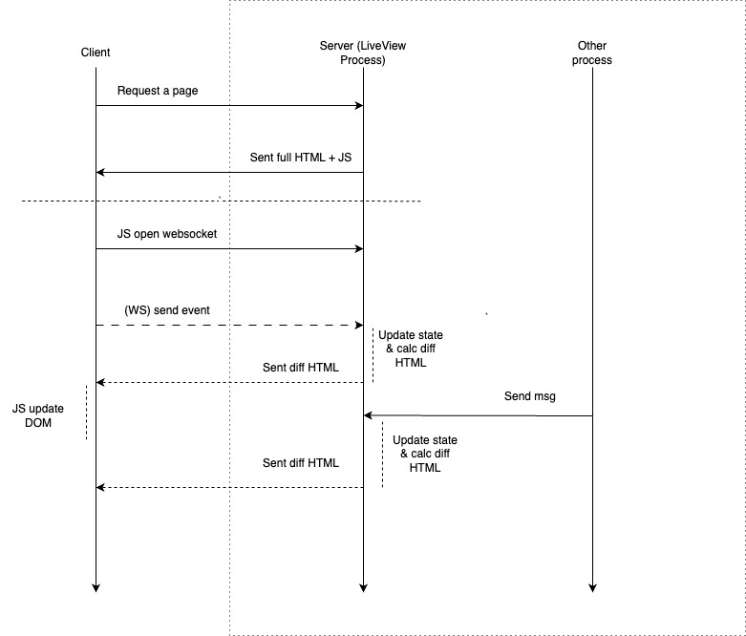

Slide 13
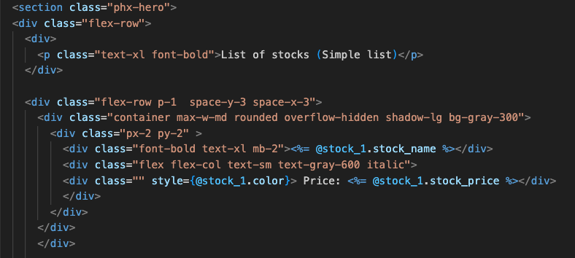

Slide 14
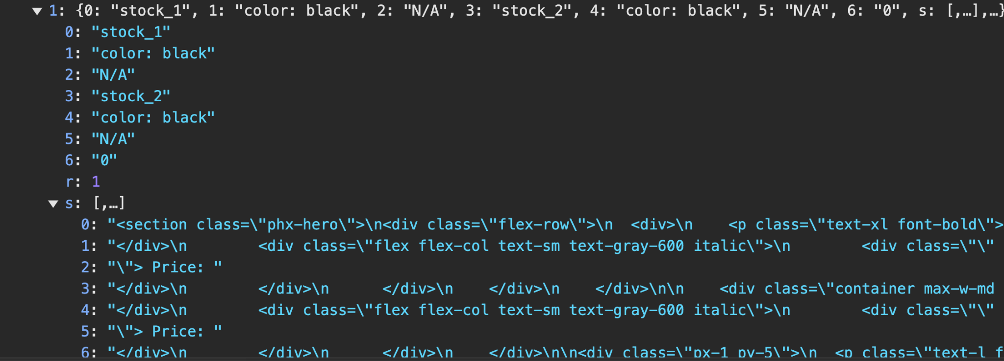
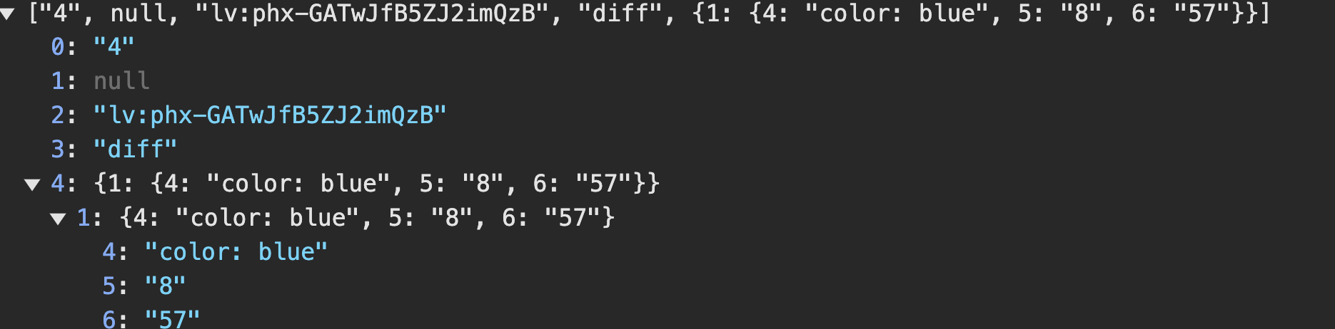

Slide 15
LiveView - Stateful
LiveView keeps state in its process in the server side.
State will lose if process was crashed (but we can store it to ETS table, or somewhere).
LiveView is natively has state in server then we don’t need to work much.
We can support some advantage technique to improve UX (ex: Sync state between devices, restore state from crash/last time visited,...).
Note: State is stored in socket.assigns

Slide 16
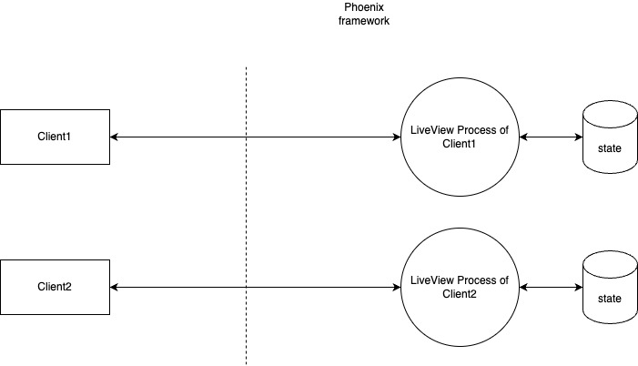
Each client has it owner process & state (socket.assigns for render HTML).

Slide 17
LiveView - Real-time event
LiveView provides a real-time & low latency event for both sides (client -> server, server -> client).
Every things is ready, we just need to add our code for processing event only.

Slide 18
LiveView - Real-time event
LiveView provides events like mount, handle_param, handle_event, handle_async.
Optional events: handle_info, handle_call, handle_cast, terminate (from GenServer).
For event from client we use handle_event. For internal event in server side we use handle_info or handle_call/handle_cast (call from our implemented APIs to LiveView process).
Note: LiveView using heartbeat to detect client/server is alive.

Slide 19
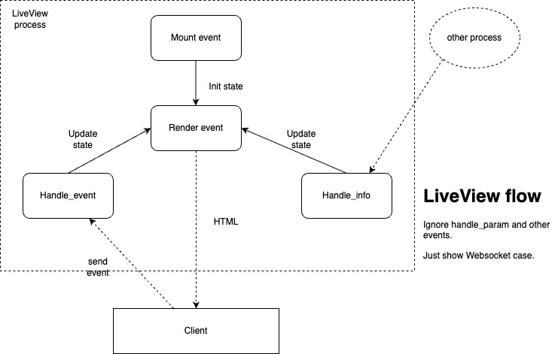

Slide 20
LiveView - Rich interactive
It’s easy to create a rich interactive web app.
In client we need add phx-* (like: <button phx-click="update_10">) event to push event to server.
In server we add handle_event to update state, LiveView process will detect state change and render a diff HTML and push to client if needed.

Slide 21
Demo
How LiveView run fast & easy to add real-time to web app.
How LiveView calculate diff HTML to reduce data send to client.
Small Elixir app show how LiveView work.

Slide 22
LiveView - Optimization Guide
Async for fast response to client, data will be pushed later.
Stream for large list need to insert/update/delete later.
Usings Hook for specialized thing (ex: update route in a map from 3rd, infinite scroll list - can work with stream, ...).
Using connected?(socket) function to ignore things that don’t need to show in first phase (get request - get full HTML).
Avoid to render dynamic content that included big list/table, it consume too much time for LiveView process to calc diff HTML.

Slide 23
Integrate with other services

Slide 24
Integration
It’s convenience when work LiveView with other Elixir services.
Can develop a distributed system quick & easily.
Elixir already support for Data analysis & AI then we can work from frontend to AI.
Our journey

Slide 25
Core features, start with umbrella project
Support connect to 3rd, publics APIs
Mining data, AI (in the future)
Core
Services
Public APIs
Scale
Big data/AI
Add other services: Account, Email, 2FA, Chat,...
Decouple & build distributed system

Slide 26
LiveView with other services
We started build core features then added more services later.
Go first with umbrella project (multi Elixir app in a project) and decouple it very quick.
Distributed programming in Elixir is very convenience, don’t much take a lot of effort like other languages.

Slide 27
Build whole system by Elixir
We use Elixir for build our system.
Anyone can go quickly to support other members.
Easy to collaborate with team.

Slide 28
Something we faced

Slide 29
Barriers
Elixir is easy to learn but OTP isn’t.
New style programming & new knowledge need to learn.
Phoenix framework is change so quick (but now is more stable).
For new people jump to Elixir/LiveView

Slide 30
Some recommended docs
Phoenix LiveView Lifecycle - The Pragmatic studio https://www.youtube.com/watch?v=ffB9gmzYJJg
Dashbit blog https://dashbit.co/blog/latency-rendering-liveview
LiveView Async features
https://fly.io/phoenix-files/abusing-liveview-new-async-assigns-feature/
LiveView Streams features
https://fly.io/phoenix-files/phoenix-dev-blog-streams/

Slide 31

Q & A
https://github.com/ohhi-vn/live_pub_demo

